Slide 1



Atulya
name : Aniket BodelE
Division : Internet of things
Ambition number: 21je0111

Slide 2
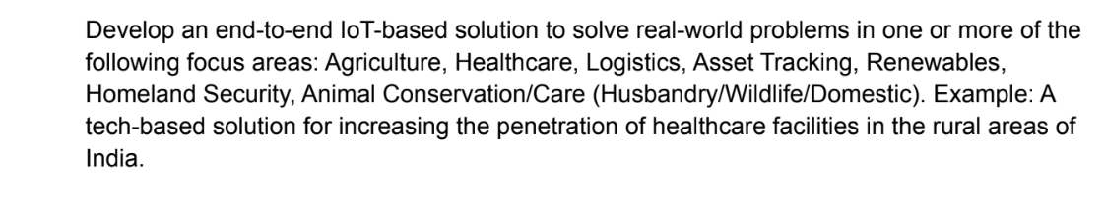
Problem statement:

Slide 3
Requirements:
Soil moisture sensor
DHT22 sensor
Pir sensor
Relay
Water pump
Raindrop sensor
DS18B20 sensor
ESP8266 Nodemcu
Buzzer
LED
Jumper wire

Slide 4
Iot project (Agriculture)
This agriculture iot project helps us to monitor the greenhouse farming without any physical presence. It provide all the necessary data and readings of the environment inside the greenhouse, so that we can monitor plants without our physical presence.

Slide 5
Working process
The working of the project is as follows:
First the sensors such as soil moisture sensor , raindrop sensor, DHT22 sensor , pir sensor ,DS18B20 sensor take the readings from the outer environment and send it to the nodemcu ,there these sensors values are pass on to the virtual keys so that they can be monitored through blynk app on android/iOS

Slide 6
Sensors such as the soil moisture sensor , temperature sensor , humidity sensor etc. will provide a continuous reading in form of scales in blynk app. If soil moisture is decreased by certain level or if there is any moment in the farm than an alert message will be send to user . For decrease in moisture case user can allow the water to flow using water pump through the buttons on app and if plants get the sufficient amount of water again a notification come that plants got the enough water.
Led display is used provide the reading of soil moisture , temperature , humidity for the person inside the farm.
Buzzer is used to provide an alert message when water in needed or when water is enough.
Rain sensor will provide an alert message on blynk that it is raining outside or not.

Slide 7
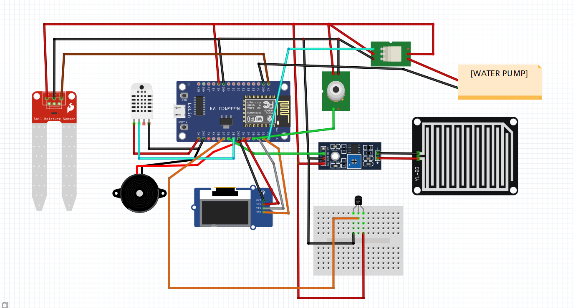
Circuit Diagram:

Slide 8

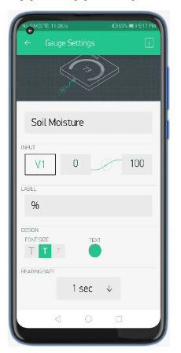
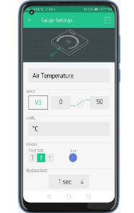
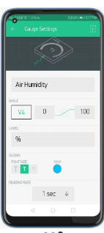
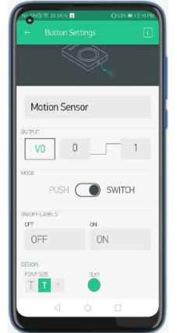
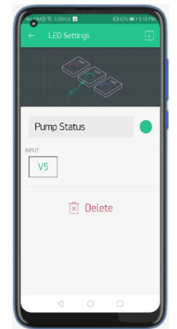
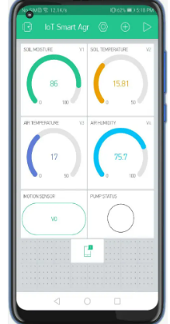
Blynk interface:

Slide 9
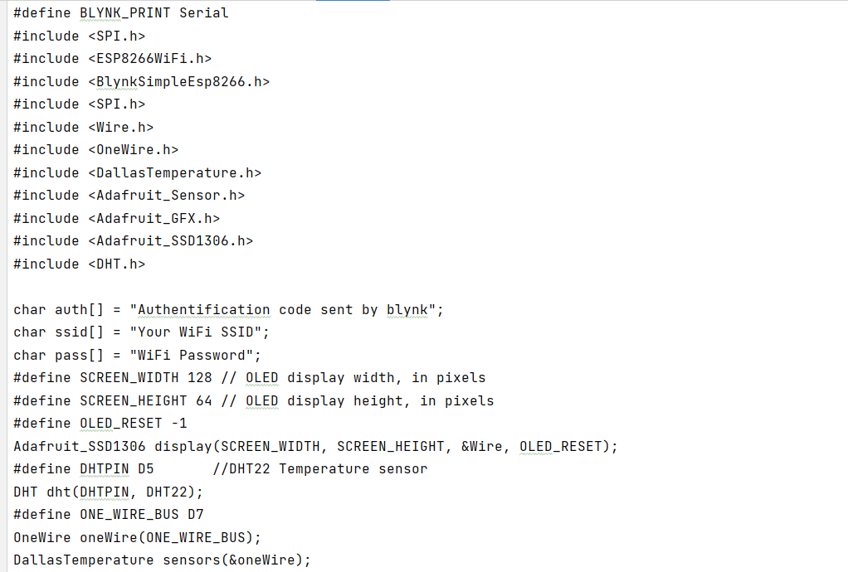
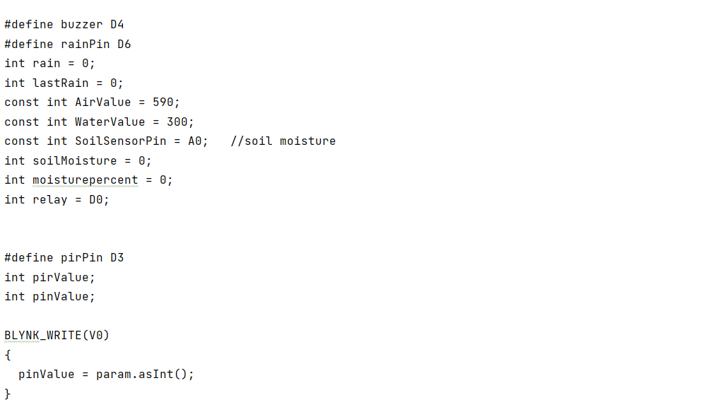
Code:

Slide 10
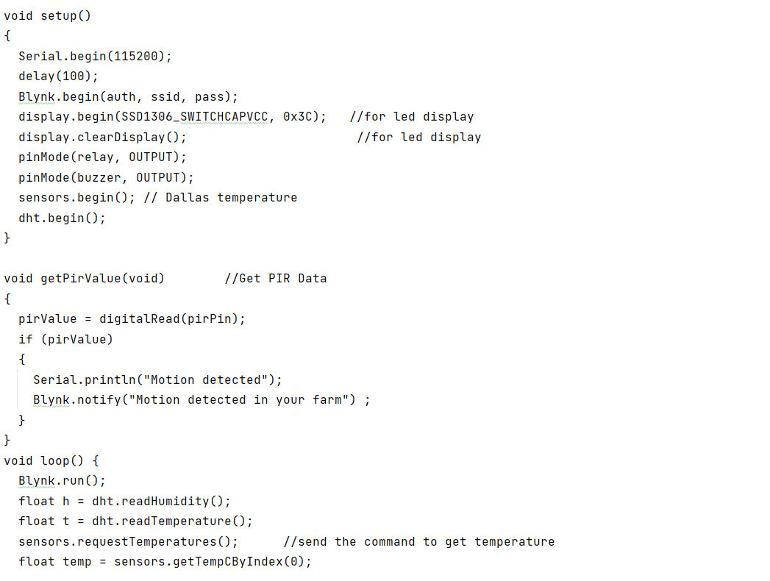
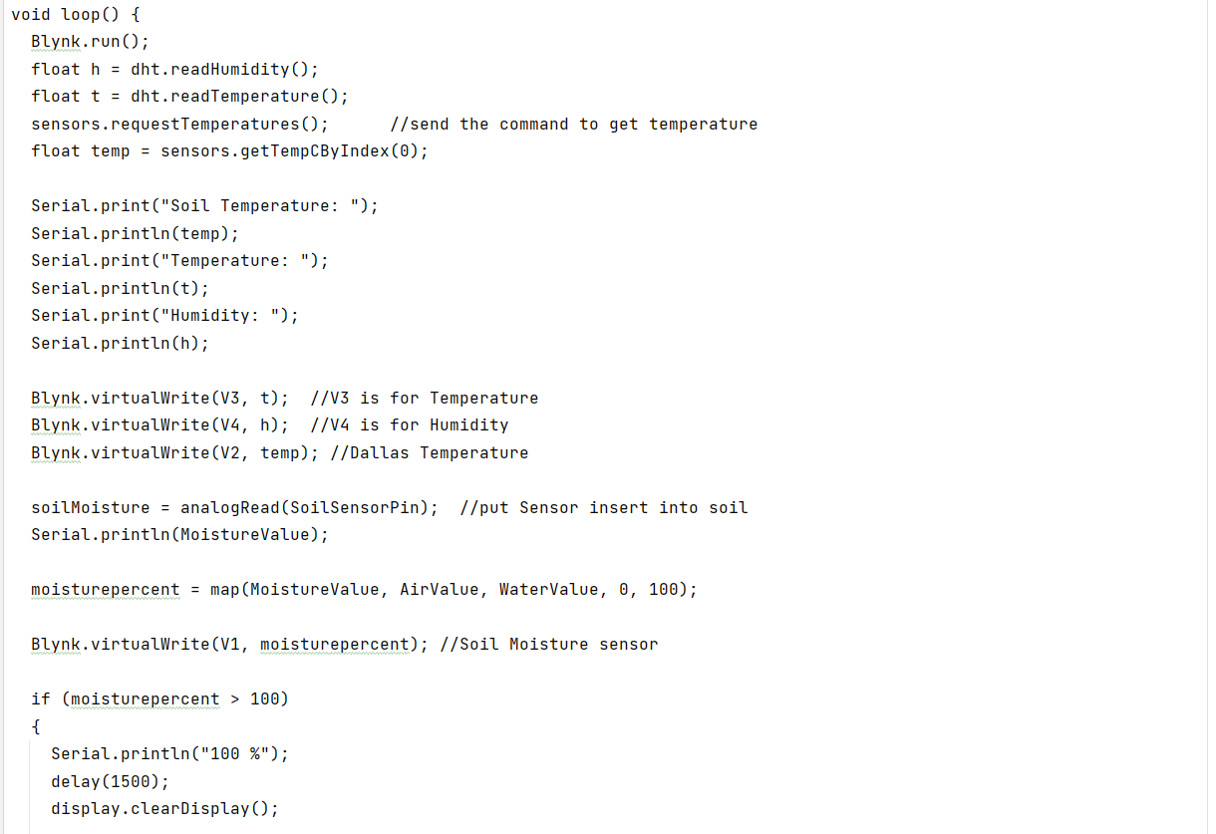

Slide 11
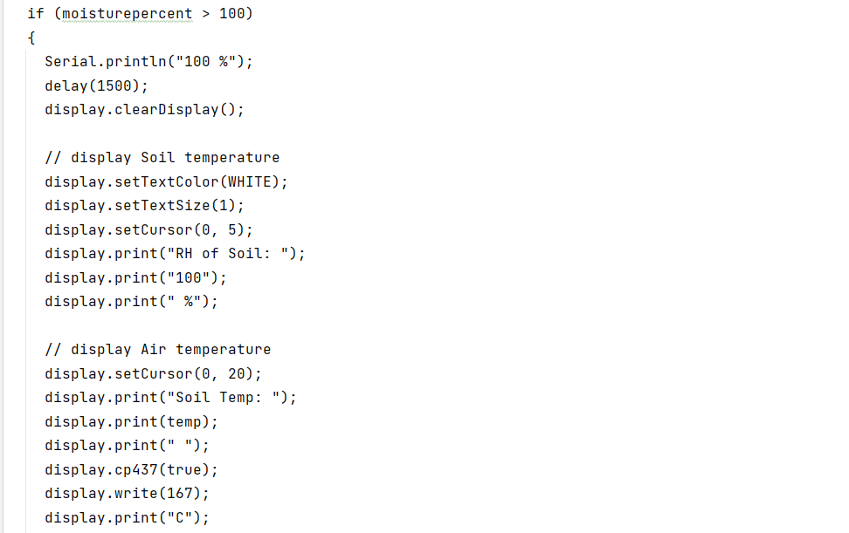
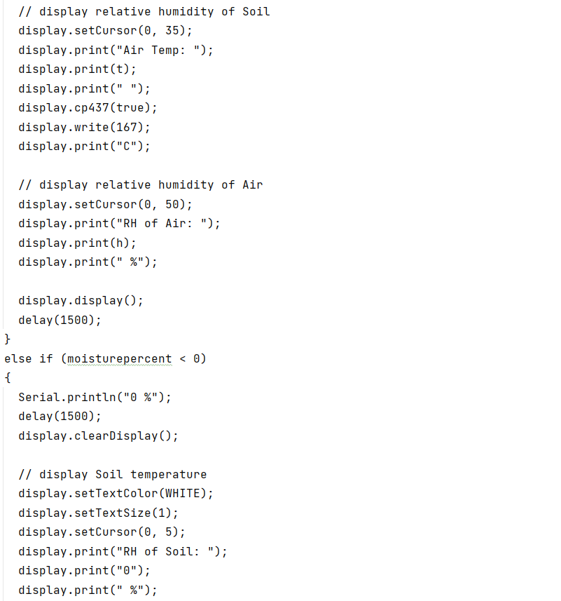

Slide 12
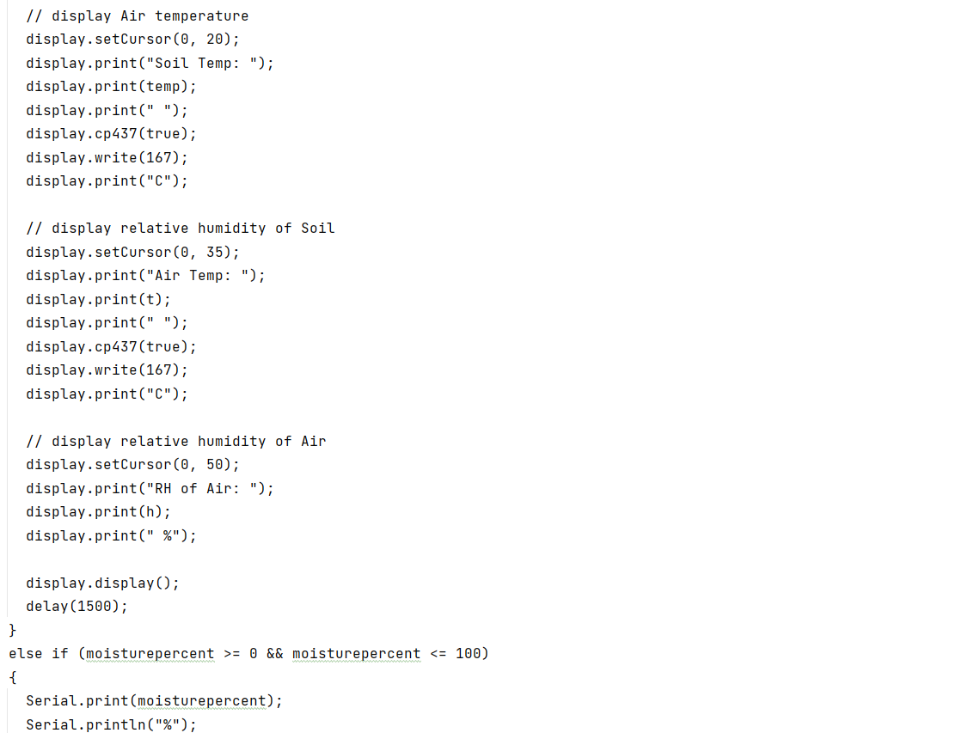
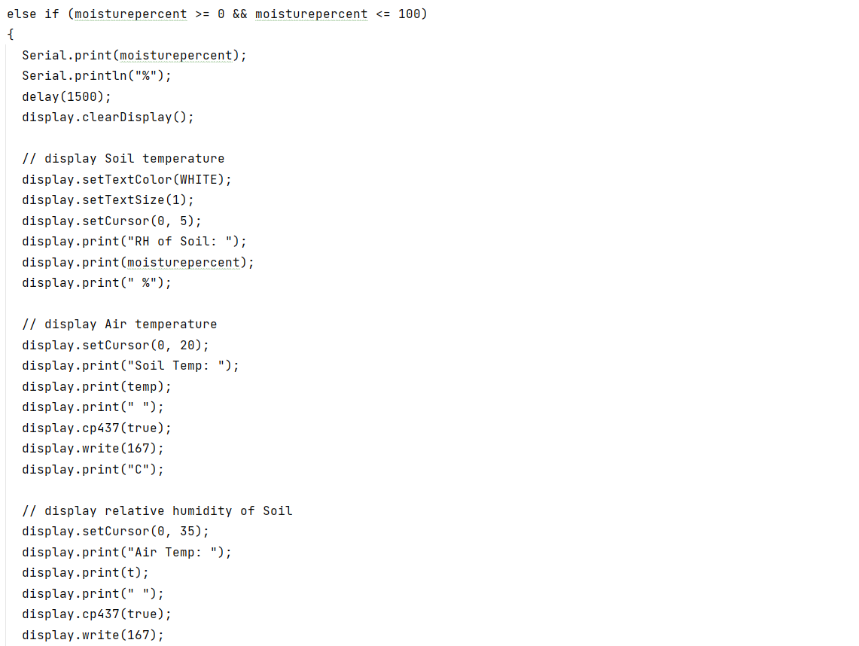

Slide 13
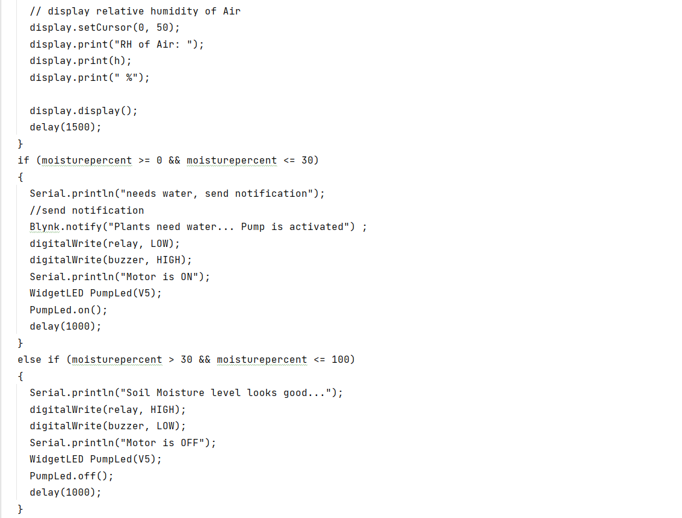
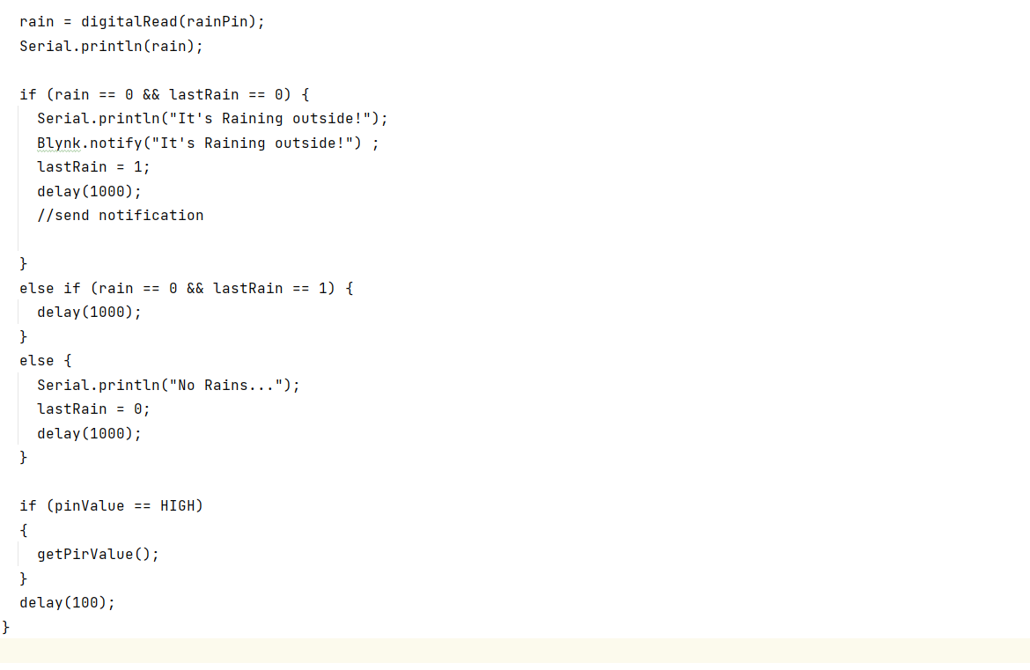

Slide 14


Slide 15


Source:
https://youtu.be/Tl4qblr5dlo

